Slide 1

Direct Policy Optimization (DPO)
- ALTERNATIVE TO RLHF

Slide 2

Why align?
Pretraining
Is pineapple on pizza a crime?
Base LLM
This is one of the many questions that will be answered at the Pizza Party …
Notes:
J

Slide 3
Why align?
Pretraining
Is pineapple on pizza a crime?
Supervised fine-tuning
SFT LLM
Yes, adding pineapple as a topping on pizza is a criminal act under the Geneva Convention
Notes:
J

Slide 4
Why align?
Pretraining
Is pineapple on pizza a crime?
Supervised fine-tuning
SFT LLM
Alignment
“Yes” 👎
“No” 👍
Collect human / AI feedback
to learn p(y_{w}﹥y_{l})
Notes:
J

Slide 5
Why align?
Pretraining
Is pineapple on pizza a crime?
Supervised fine-tuning
Aligned LLM
Alignment
No, adding pineapple as a topping on pizza is not a criminal act. It’s a matter of personal preference and taste.
Notes:
J

Slide 6
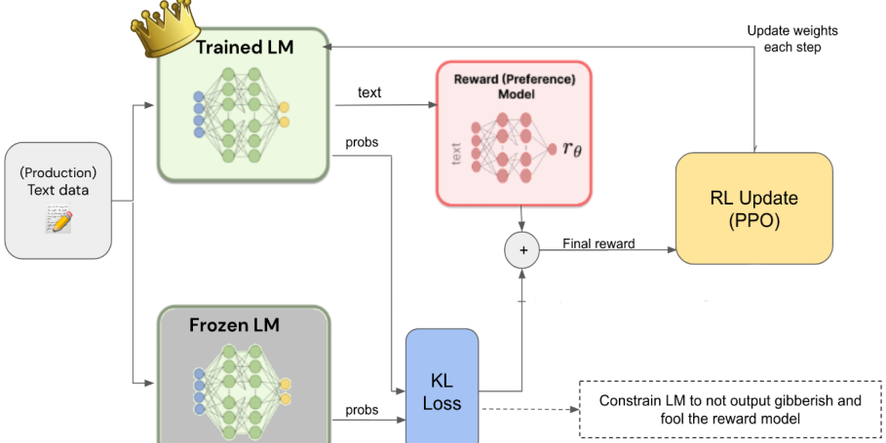
RLHF - Overview

Slide 7
RLHF Steps
🏁 Start with a Model
Give the model prompts and have it generate multiple completions.
🗣️ Collect Human Feedback
Ask humans to evaluate these responses, selecting the preferred ones, or ranking them according to certain criteria.
💳 Train a Reward Model
Use the collected human feedback to train a reward model.
This model learns to predict the human preference between pairs of responses.
The reward model approximates human judgments, assigning higher scores to more preferable responses.
The reward model must output a scalar value score (ie, just a number) to each output generated by the LLM

Slide 8
RLHF Steps contd.
4. 🤖 Do Reinforcement Learning
Make a duplicate copy of the language model and freeze it's weights. Now we have two models: one whose weights will be updated via back prop, and one that will not be updated.
Generate completions from both the models. Measure how much the trainable LM's text predictions drift from the frozen one using KL divergence loss.
Add that KL divergence loss to the reward from the reward model.
Use the trained reward model to fine-tune the base model further.
This step involves reinforcement learning algorithms, usually Proximal Policy Optimization (PPO).
Optimize the policy of the base model to generate responses that maximize the predicted reward from the reward model.

Slide 9
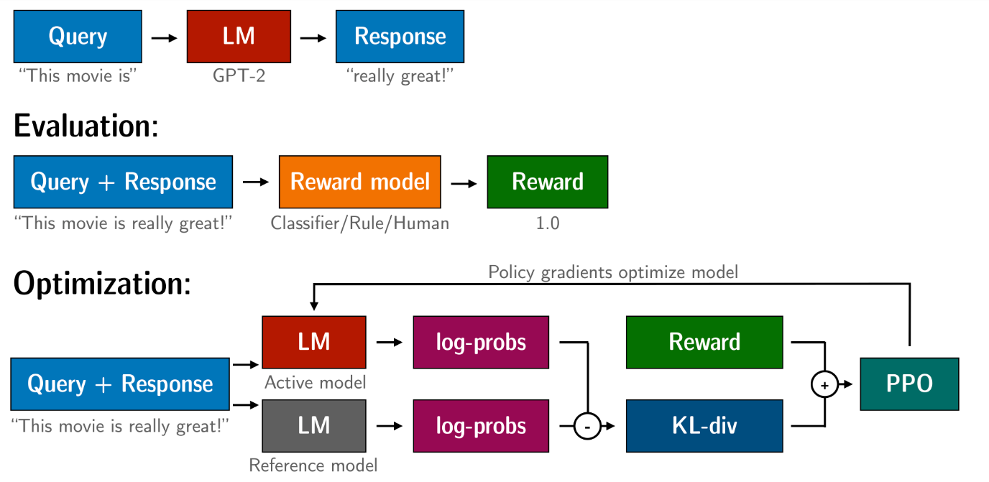
RLHF – contd

Slide 10
Drawbacks of RLHF
Dependence on Initial Training Data
RLHF models are often initially trained on a dataset before receiving human feedback. If this initial dataset is biased or unrepresentative, it can lead to suboptimal or skewed learning outcomes.
Quality and Consistency of Human Feedback
Human feedback can vary greatly in quality and may be inconsistent, especially if coming from multiple sources.
This variability can lead to confusion in the learning process and slow down the convergence of the model.
Scalability Issues
Continuously incorporating human feedback into the training process can be time-consuming and may not scale well, especially for complex tasks or large-scale applications.
Balancing Exploration and Exploitation
RLHF methods often struggle to balance exploration (trying new actions) and exploitation (relying on known good actions).
Overemphasis on human feedback can lead to reduced exploration, potentially missing out on discovering optimal strategies.

Slide 11
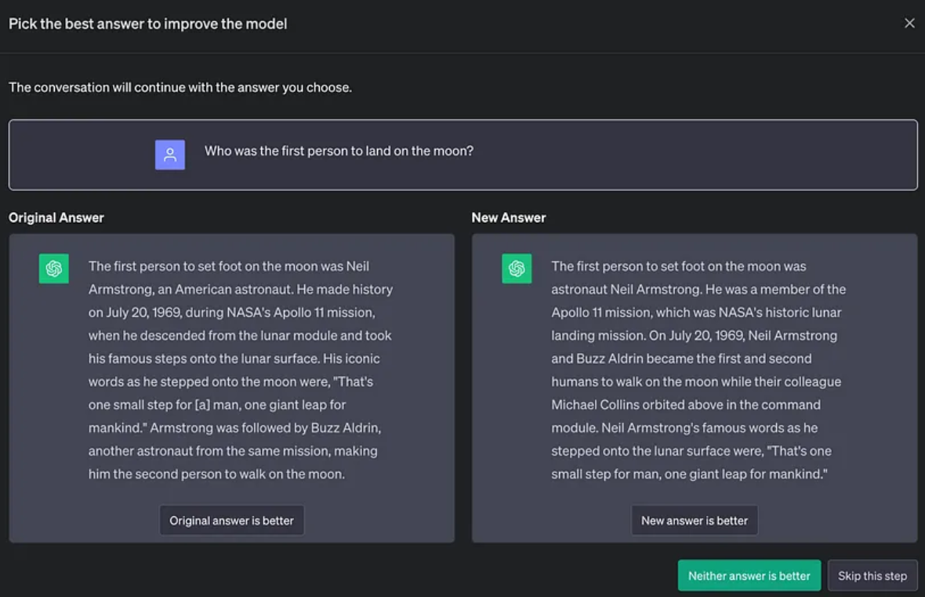
DPO - Overview
The objective of DPO is the same as RLHF: improve the alignment of language models to human preferences.
DPO is applied to preference data, which consists of a dataset of triplets (prompt, chosen answer, rejected answer)
This type of data is also collected for RLHF, to train a reward model, that is later used to train the model with RL.
However with DPO, the model is directly optimized in this preference data without using any reward model.

Slide 12
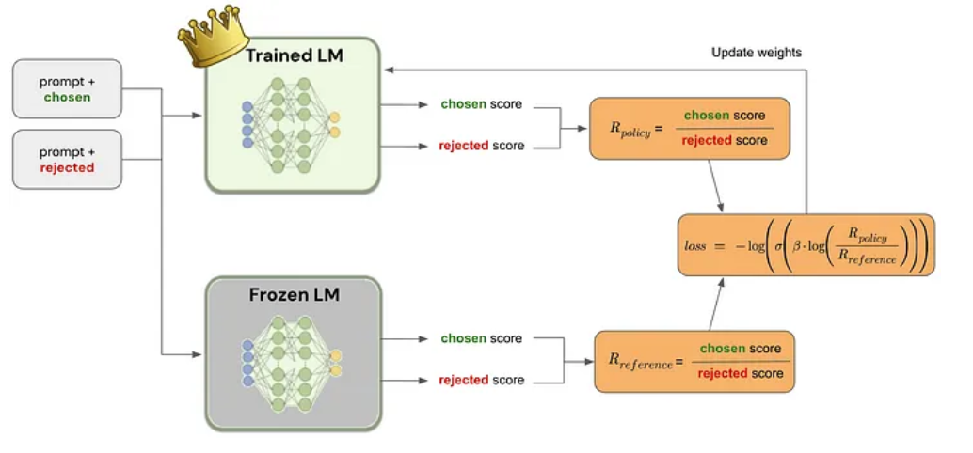
DPO - Pipeline

Slide 13
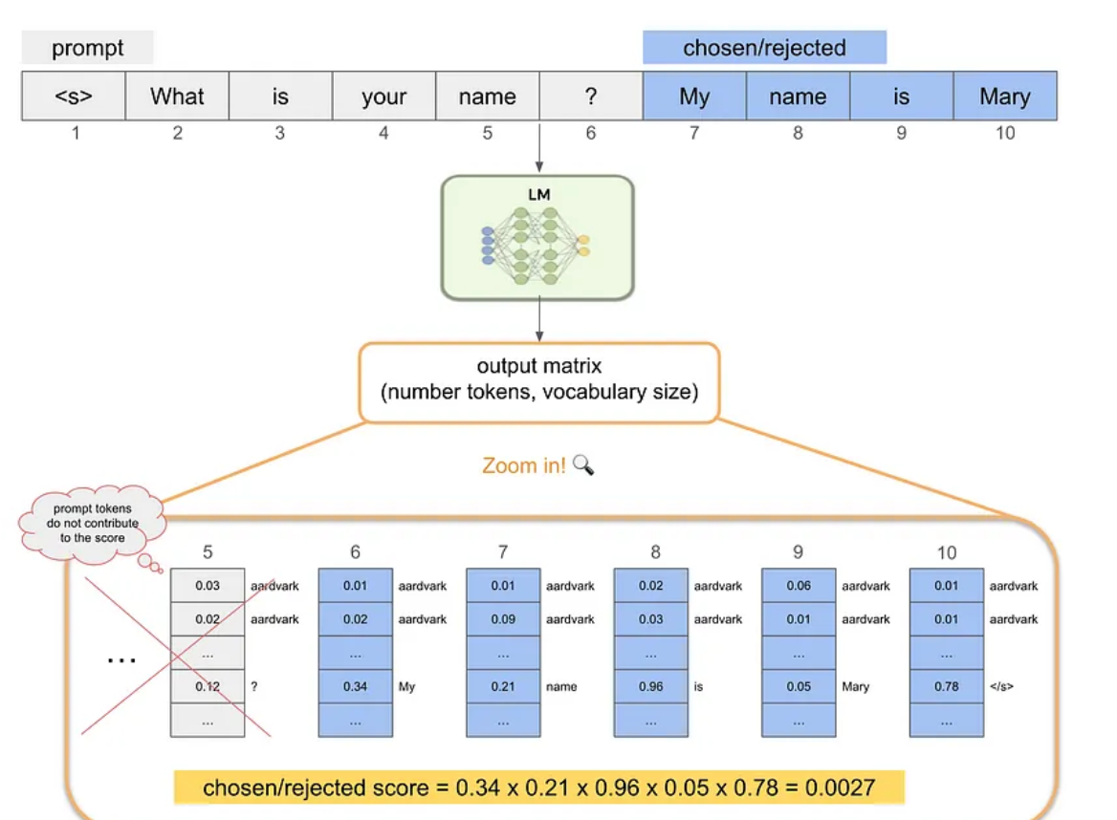
DPO : Training Details
At the beginning of the fine-tuning process, an exact copy is done for the language model that is being trained, and its trainable parameters are frozen.
For each data point, the chosen and rejected responses are scored by both the trained and the frozen language model.
This score is the product of the probabilities associated with the desired response token for each step.
Since these generative LM are causal decoder, we can calculate this score in a single forward pass.

Slide 14
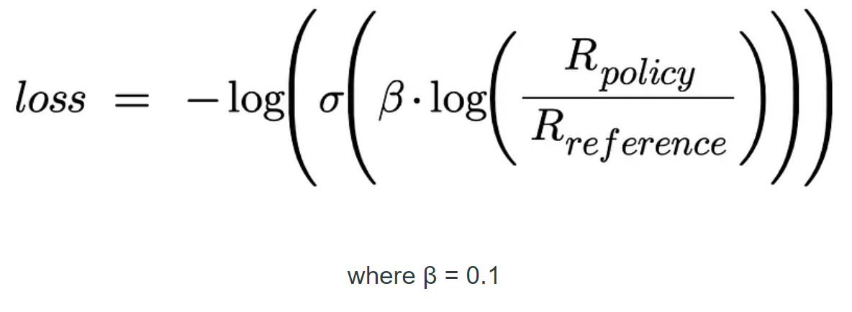
DPO : Training Details contd.
With the chosen and rejected responses scored, we can calculate the ratio between the scores given by the trained language model, R_{policy} and the ones given by the frozen LM, R_{reference}
These ratios are then used to calculate the final loss that is used to modify the model weights in the gradient descent update:

Slide 15
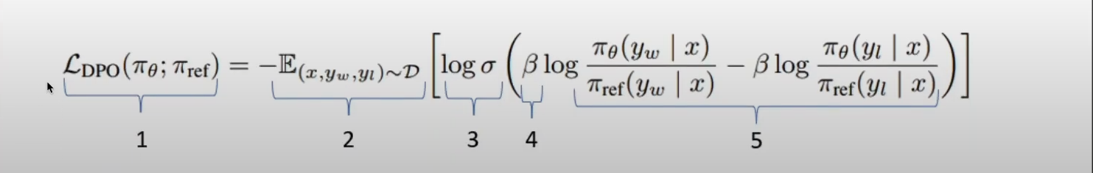
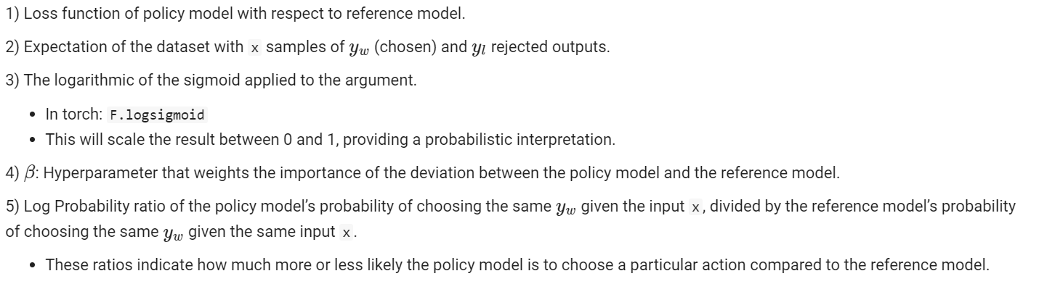
DPO Loss-function

Slide 16
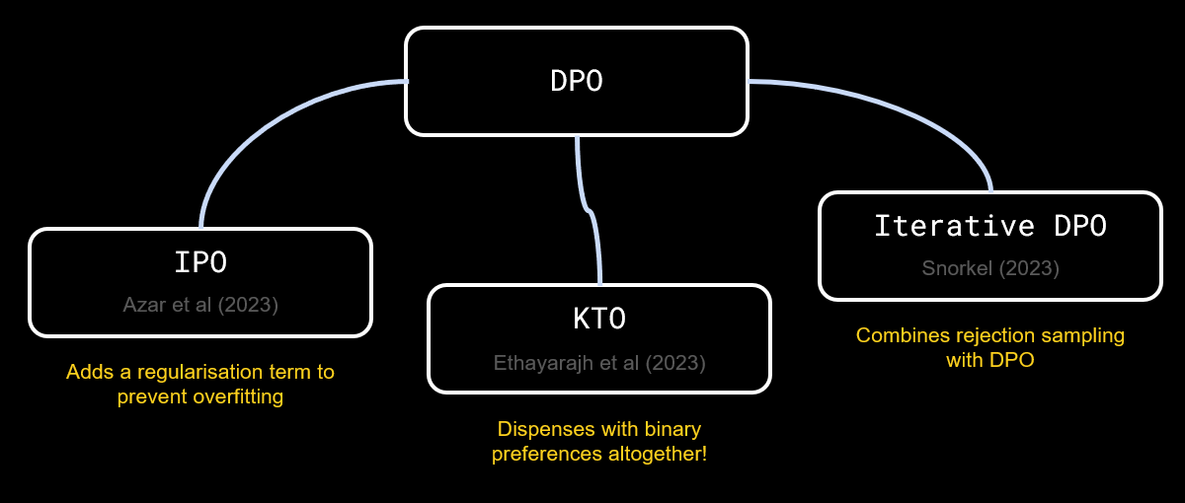
Reference notebook & beyond DPO
- DPO training notebook link from ERA1 – S26 : https://colab.research.google.com/drive/15iFBr1xWgztXvhrj5I9fBv20c7CFOPBE?usp=sharing

